Slide 2

Get testing with SeLion
OSCON 2016
Doug Simmons, PayPal
Notes:
Slides will highlight
Features available in SeLion 1.0.0 as well as some in the pending 1.1.0 release.
Basic examples

Slide 3
A Familiar Story
Too much manual effort to run tests
Existing solution limits scale
Proprietary tools
E.g.
Parallelization is not available or limited
Limited/no data driven capabilities
Limited browser support
Thousands of test cases -- requiring weeks to regress
Poor reuse / Inefficient practices
No developer parity
Notes:
Key Points:
We didn’t really have a solution that scaled or met our functional and business needs in 2010
Developers did not concern themselves with Test
There was no concept of CI and Continuous Testing
Tools that we embraced did not provide enough programmatic constructs to meet the job and were proprietary / did not allow us to target hire
There was no parity with developers
Teams often do no define test boundaries and/ or break down their test approach into unit, service, functional

Slide 4











Open Source Offerings
To name a few
Selenium WebDriver
Appium
Selendroid
ios-driver
TestNG
Maven
Apache POI
Notes:
- There are many open source projects you can build on that are already in the space – some are more mature than others
Integration can be difficult – SeLion is an integration which aims to reduce the friction associated here.

Slide 5
Selenium WebDriver Basics
W3C draft @ https://www.w3.org/TR/webdriver/
Selenium
Client
WebDriver
Implementation
Application
JSON Wire Protocol
over HTTP
“Native” code
Notes:
Before we continue, let’s get everyone on the same page;
Review of WebDriver basics:
1. JSON Wire Protocol, is HTTP based
2. A WebDriver implementation receives wire protocol as input and instruments ”native code” to control the target application
3. Applications are typically web browsers and mobile apps (on a device – iOS and Android) -- though the wire protocol does not restrict.

Slide 6
Selenium Grid Console
Notes:
Screenshots of the Selenium Grid console.
Here HTTP (selenium) proxies are introduced to address scale.
Each browser or device icon is a “test slot”, which can handle a single test session
Each box which contains 1 or more test slots is a selenium node
The totality of all the nodes is a Selenium Grid
A special type of proxy called a ”hub” reserves and routes traffic to a test slot in the overall grid.

Slide 7
Project Goals
Reduce friction / enable test
Add value
Build on open source
Build for reuse
Community driven
Notes:
SeLion project goals

Slide 8
SELION ENHANCED GRID
Notes:
Before we write tests let’s highlight a few of the server-side selenium enhancements which available with SeLion

Slide 9
Familiar Startup
Launching a SeLion Grid is similar to the selenium standalone jar
Hub, Node, or Standalone instance(s) by created with java –jar SeLion-Grid-{version}-jar-with-dependencies.jar
Configuration, dependencies, logs saved to ${HOME}/.selion or the location specified via –DselionHome
Also available as images on docker hub
Notes:
https://github.com/paypal/SeLion/releases/download/v1.0.0/SeLion-Grid-1.0.0-jar-with-dependencies.jar

Slide 10
List All Nodes Servlet
JSON or HTML
Notes:
1. Servlet which can be used to query node information.
2. An alternative to the default selenium console
3. A console which can be accessed without the need to screen scrape html code.
4. Useful for monitoring needs.
5. HTML version is simply a rendering of the raw JSON version – nothing here happens without the JSON version

Slide 11
Upgrade Nodes
Notes:
A servlet which allows you to perform an upgrade across the selenium grid deployment – in real time.
Upgrade selenium version
Upgrade driver versions (chromedriver, IEDriver, etc)
Useful for static deployments where the ability to pre-create / automate deployment of VM images, containers, other -- are not an option.

Slide 12














Hub Storage
Selenium Grid
CI Job
Upload mobile app to:
selion-hub-storage
sauce-storage
Download mobile app from:
selion-hub-storage
sauce-storage
Test Case
Use mobile app
Notes:
Talking points;
Unlike a Web site, where the SUT is available on the network, there is a need to install (and therefore host somewhere) the SUT (mobile app bits) on the connected device.
“selion-hub-storage” is a solution which has parity with 3rd party solutions like Sauce lab’s implementation known as ‘sauce-storage’. This solution can be deployed on your network and is part of SeLion Enhanced Grid. It runs on the hub process and is multi-tenant aware.
With selion-hub-storage you get a predicable app location which can be used in test code.

Slide 13
Sauce Labs Virtual Proxy
Notes:
A “virtual node” which allows to proxy requests to Saucelabs.
Can configured to use a fixed Saucelabs account and/or require users to specify their Saucelabs credentials as DesiredCapabilities.

Slide 14
Writing Tests

Slide 15
Reduce Boilerplate / Web Test
Notes:
Mention:
1. @WebTest
2. No browser specified here – It is defined @ Runtime via convention or configuration
3. The effort to log results including screenshots is rolled up into a one-liner

Slide 16
Mobile Test
Annotation for performing tests on mobile devices/emulators
Physical & simulators / hybrid, native, and web
Appium, selendroid, and ios-driver
No instrumented app code required
Notes:
Similar to @WebTest but for mobile use cases.

Slide 17
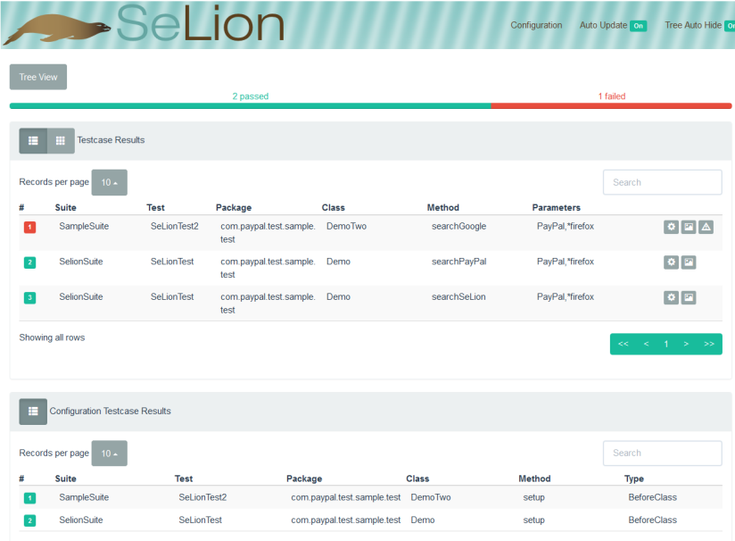
Runtime Reporter
Provides real time test status
HTML page or JSON document
Screenshots, failure logs, environment meta-data, etc.
As a Dev, I want the ability to see test results in real-time for my CI jobs
Notes:
- Default Reporter for SeLion.
- Can be extended by implementing some java calls to include additional information such as: Org name, build number, tester login id, etc.

Slide 18
Notes:
Demo @WebTest and @MobileTest

Slide 19
Elements
Abstraction for something you want to interact with or validate.
Built on-top of Selenium’s WebElement interface
Expose additional capabilities such like;
Perform action with expectation
Containers
SeLion Client
Link
Button
Form
RadioButton
…
Notes:
SeLion elements expose all of the capabilities you get with Selenium and add some additional capabilities.

Slide 20
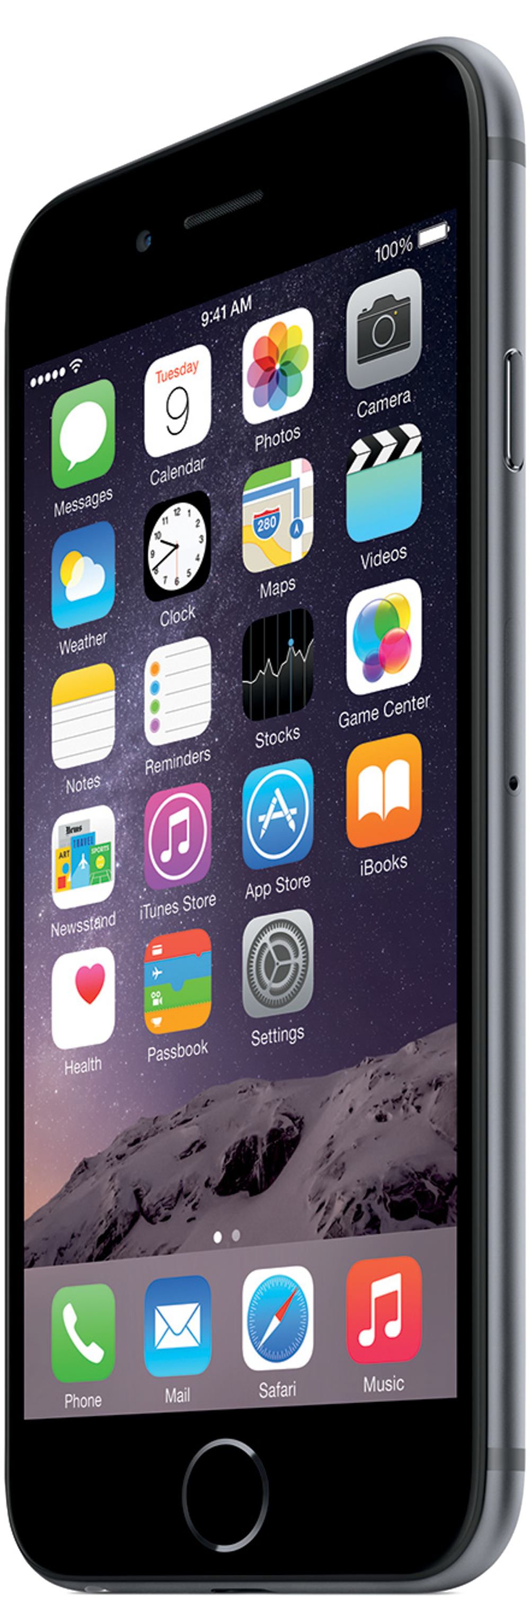
iOS Elements
SeLion Client
UIAElement
UIAButton
UIAStaticText
…
UIASwitch
iOS Driver
Appium-iOS Driver
Notes:
Talking Points;
1. Mobile Elements in SeLion can be used to interact with both ioDriver and Appium-iOS
Designed inline with UI Automation framework of iOS.
iOS mobile elements named after iOS UI Automation classes.
Seamless transition for iOS testers experienced in UI Automation framework.
iOS mobile elements remains the same for iOS Driver and Appium-iOS Driver mobile drivers.
iOS mobile elements have built-in wait functionality.
Extensible design to accommodate new elements in the future.

Slide 21
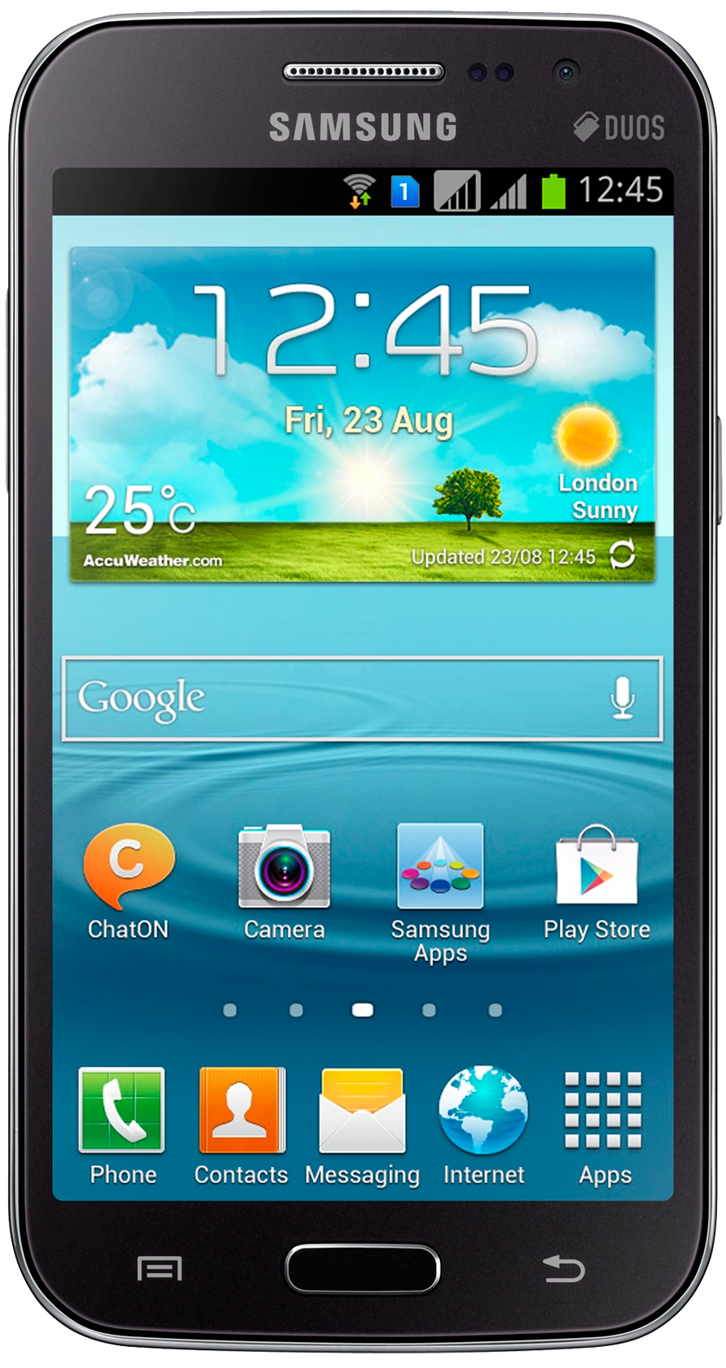
Android Elements
SeLion Client
UiObject
UiButton
UiTextView
Selendroid
Appium-Android
Notes:
Talking Points;
Mobile Elements in SeLion can be used to interact with both Selendroid and Appium-Android
Designed inline with UI Automator framework for Android.
Android mobile elements named after UI Automator APIs.
Seamless transition for Android testers experienced in UI Automator.
Android mobile elements remains the same for Selendroid and Appium – Android mobile drivers.
Android mobile elements have built-in wait functionality.
Extensible design to accommodate new elements in the future.

Slide 22
Cross-Platform Mobile Elements?
Notes:
Coming soon…
Currently open as a branch against on the main repo

Slide 23
Element Event Listening
Hook into specific element events such as;
beforeClick, afterClick
beforeType, afterType
beforeSubmit, afterSubmit
etc.

Slide 24
Page Objects
Abstraction which represents a page or screen (web or mobile)
Reusable and easy to maintain
Wired together to accomplish a flow
Notes:
An Object to Encapsulate UI Elements
Consumption of Page Object’s by test code.

Slide 25
SeLion Page Objects
Multi Locale
Validators built-in
Extensible
Written in YAML markup -> PageYAML
Java code generated via a maven plugin
Mobile & Web
Notes:
Additional Talking points;
Opportunity to create a Page Object Repository

Slide 26
Notes:
Demo of PageYAML and the SeLion code generator

Slide 27
Event Listening
Hook into driver events, before / after
Mobile and web
Loosely coupled with driver implementations
Implement EventListener
Tell SeLion to use it
Run tests

Slide 28
Event Listening

Slide 29
Data Providers
Separating test data
SeLion Data Provider
Data source
Test
JSON / YAML / XML / XLS
Notes:
Testers already had large Excel spreadsheets of test data that they wanted to use
TestNG @DataProviders required creation of something that returned Object[][]
Deserialization/Unmarshalling test data into POJO – nice to have
…. Binary files = tough to manage changes in source control tools like git
So, we did this for YAML data sets too!

Slide 30
Data Providers

Slide 31
Data Provider Filters
Excel Data Provider
YAML Data Provider
JSON Data Provider
XML Data Provider
FILTER

Slide 32
Data Provider Filters

Slide 34
Get Involved
http://selion.io
Fork the code – http://github.com/paypal/SeLion and http://github.com/paypal/docker-selion
Follow the conversation on Gitter – http://gitter.im/paypal/SeLion
Join our google group - https://groups.google.com/forum/#!forum/selion
Notes:
Ways to contribute;
Documentation
Code
Videos
Ideas
Community support
Etc.

Slide 35
Thank You

